Slide 1
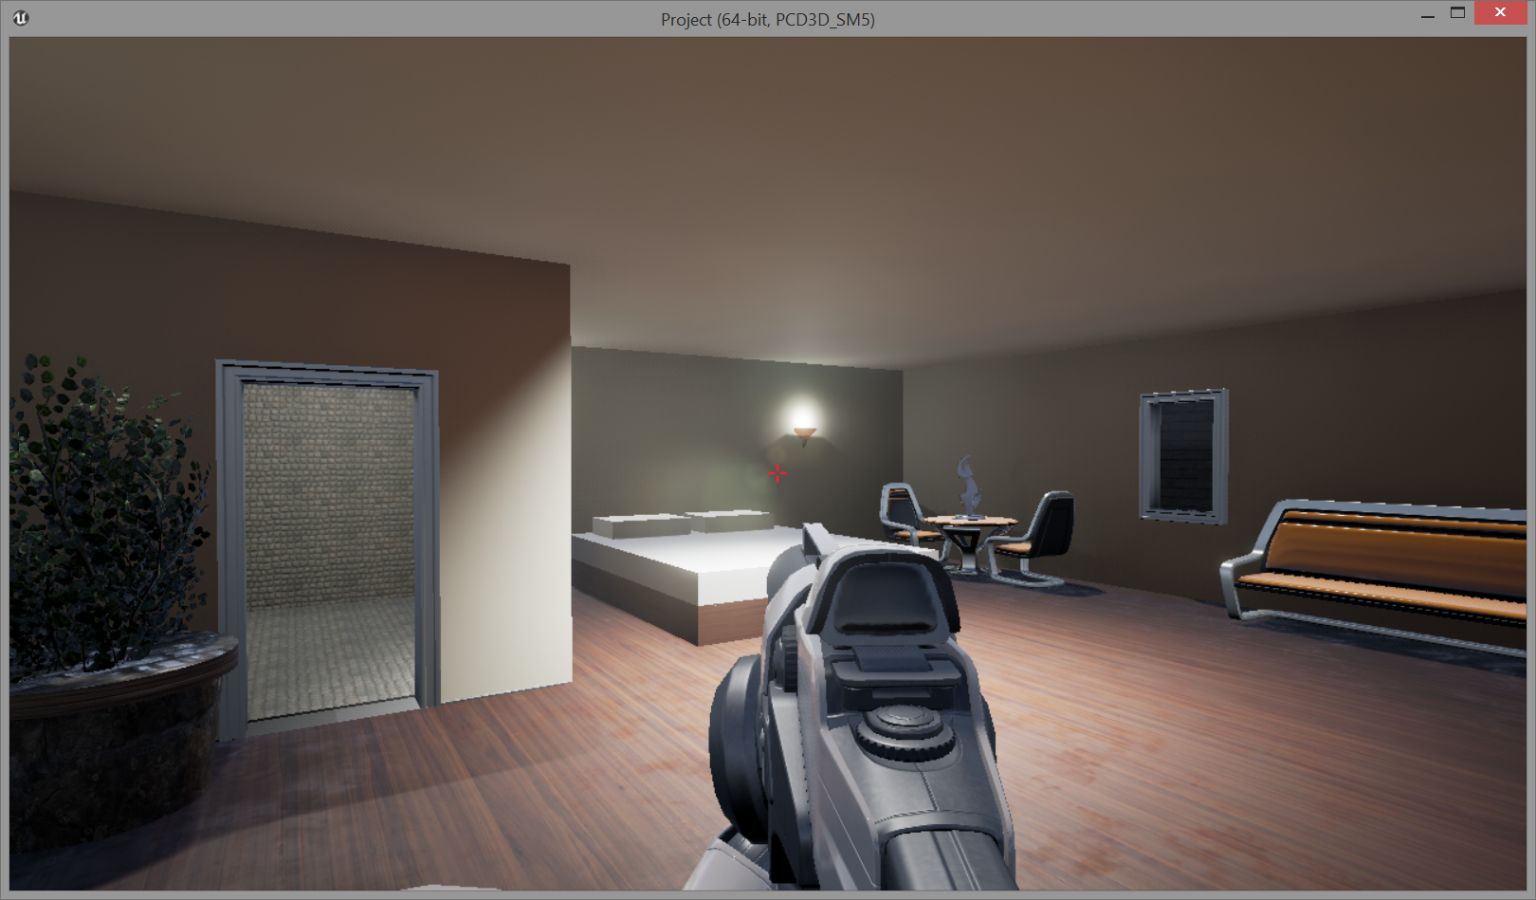
C434 Project
Jason Lytle & Michael Weathers

Slide 2
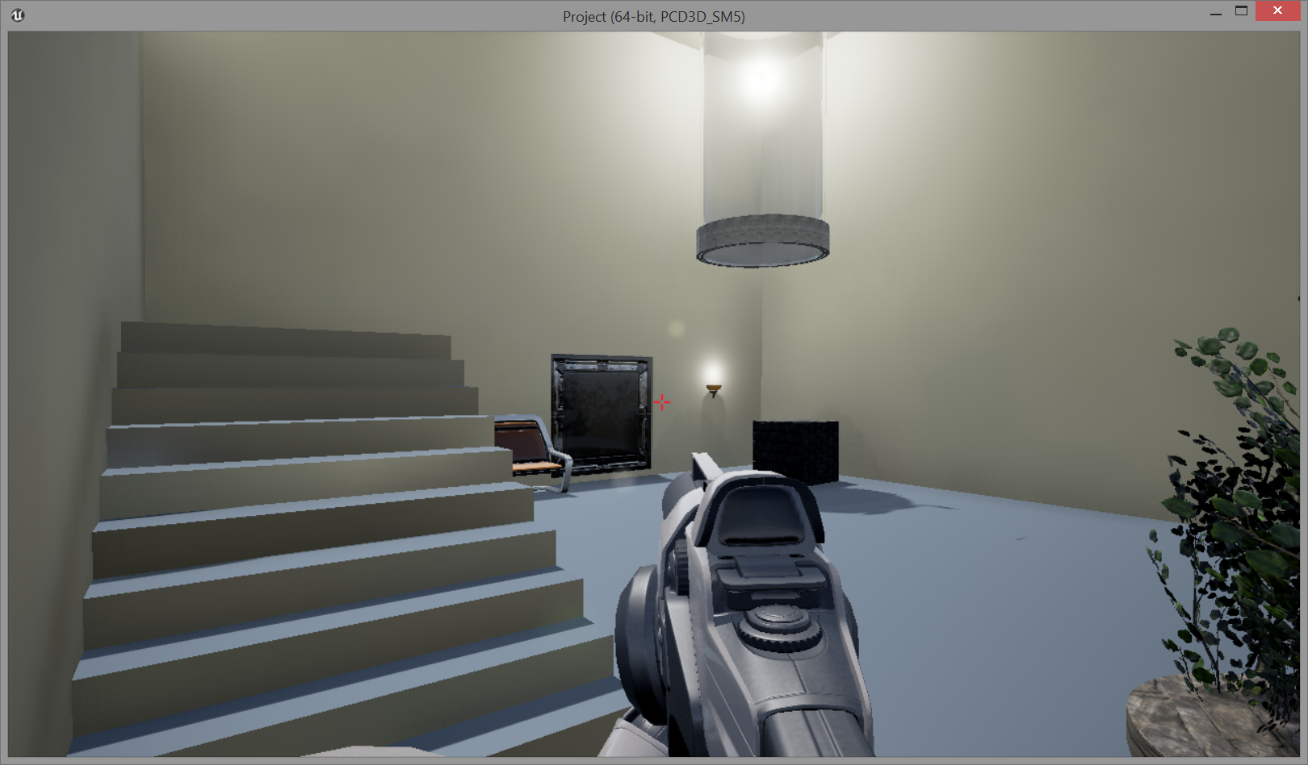
Parallel Code
Unreal Engine uses Nodes to connect the methods together.
All the connections are done in simple parallel
This enables the methods to work independently of one another (when possible).
This makes it so a player can move while doing another task, or in our case, picking up items/props.
Branches with true/false values will not work independently. These have to wait for the return of true or false to continue.

Slide 3
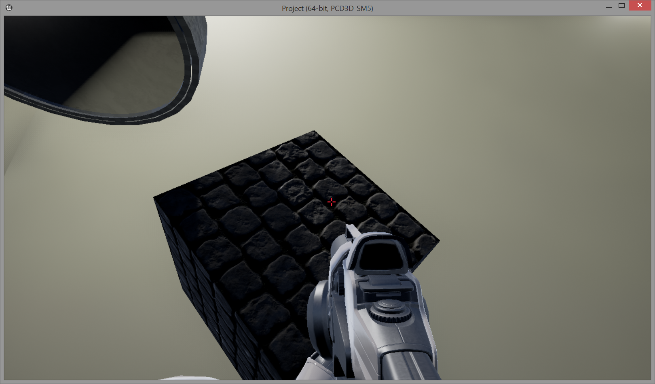
Pick Up Items/Props

Slide 4
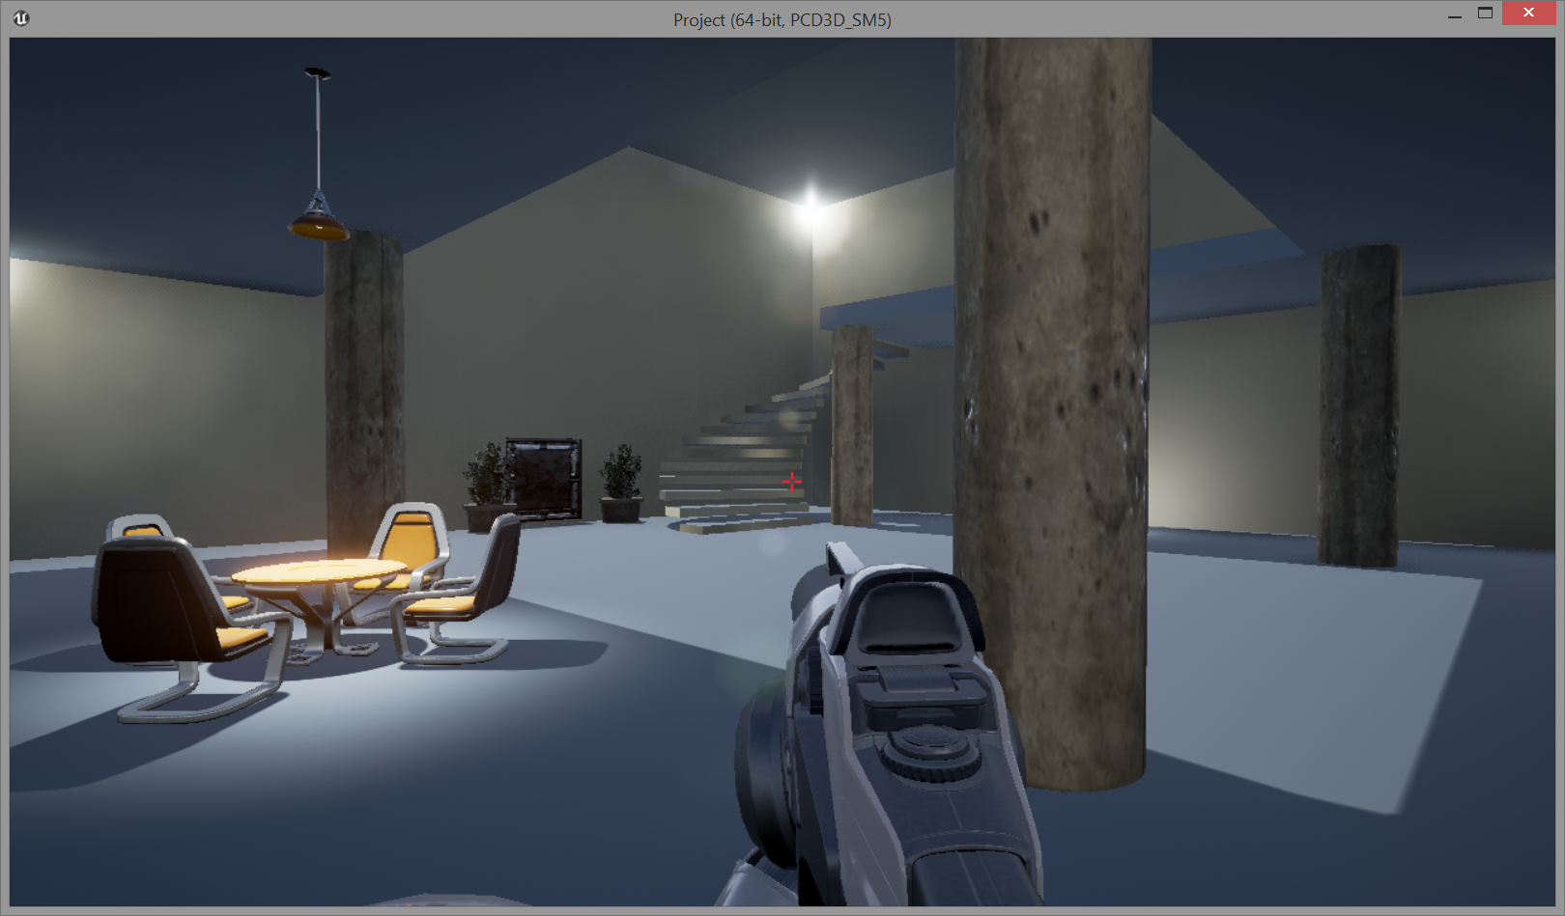
GetActorLocation
FunctionReference=(MemberName="K2_GetActorLocation",bSelfContext=True)
Pins(0)=EdGraphPin'EdGraphPin_4972'
Pins(1)=EdGraphPin'EdGraphPin_4973'
Current location of player, not including the direction that they are facing
Important to include because the player location might change when the item/prop is moved.

Slide 5
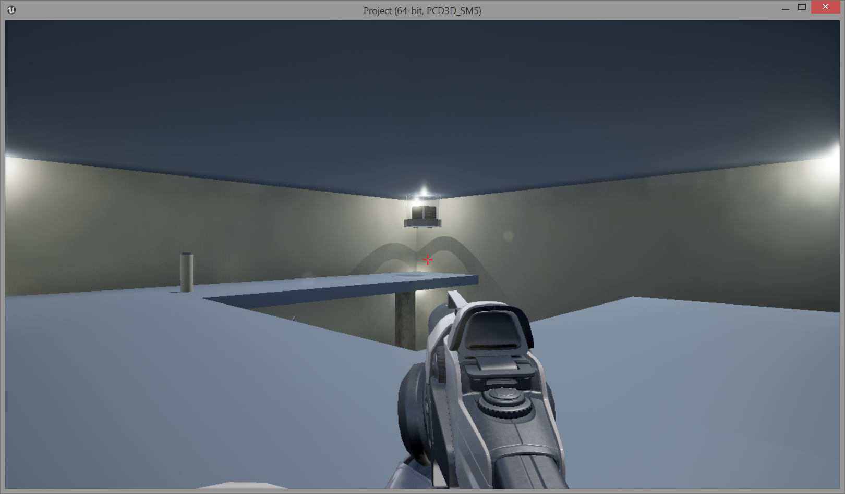
GetActorRotation
FunctionReference=(MemberName="K2_GetActorRotation",bSelfContext=True)
Pins(0)=EdGraphPin'EdGraphPin_4978'
Pins(1)=EdGraphPin'EdGraphPin_4979'
This factors in the direction that the player is facing.
Important to include because rotation will change when the player moves a item/prop

Slide 6
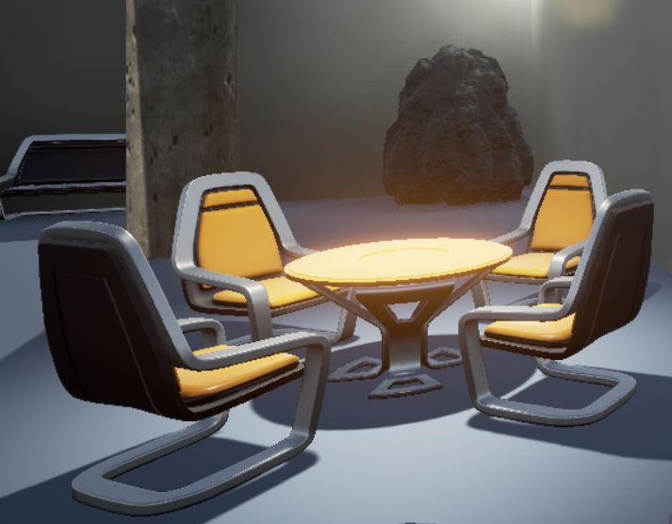
GetComponentLocation
FunctionReference=(MemberParent=Class'/Script/Engine.SceneComponent',MemberName="K2_GetComponentLocation")
Pins(0)=EdGraphPin'EdGraphPin_4951'
Pins(1)=EdGraphPin'EdGraphPin_4952‘
Starting location of item/prop to be picked up.
This is the prop that is currently in the onscreen crosshairs
This will change as the player moves the prop

Slide 7
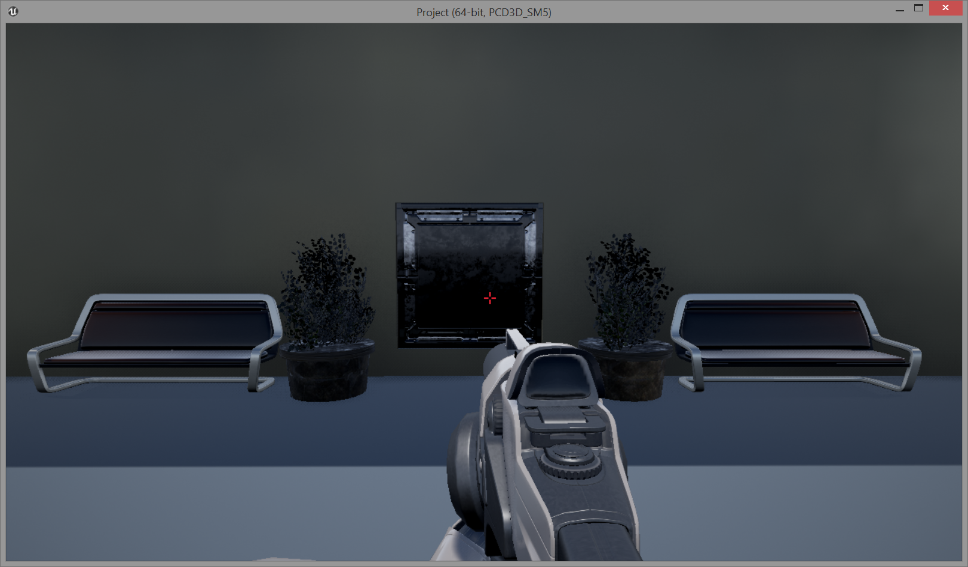
SetTargetLocationAndRotation
FunctionReference=(MemberParent=Class'/Script/Engine.PhysicsHandleComponent',MemberName="SetTargetLocationAndRotation")
Pins(0)=EdGraphPin'EdGraphPin_5248'
Pins(1)=EdGraphPin'EdGraphPin_5249'
Pins(2)=EdGraphPin'EdGraphPin_5250'
Pins(3)=EdGraphPin'EdGraphPin_5251'
Pins(4)=EdGraphPin'EdGraphPin_5252'
Sets the ending location of the item/prop
This time, rotation is included. This is because gravity takes over (partially) on this part.
If an item/prop is dropped, then the rotation can be almost anything

Slide 8
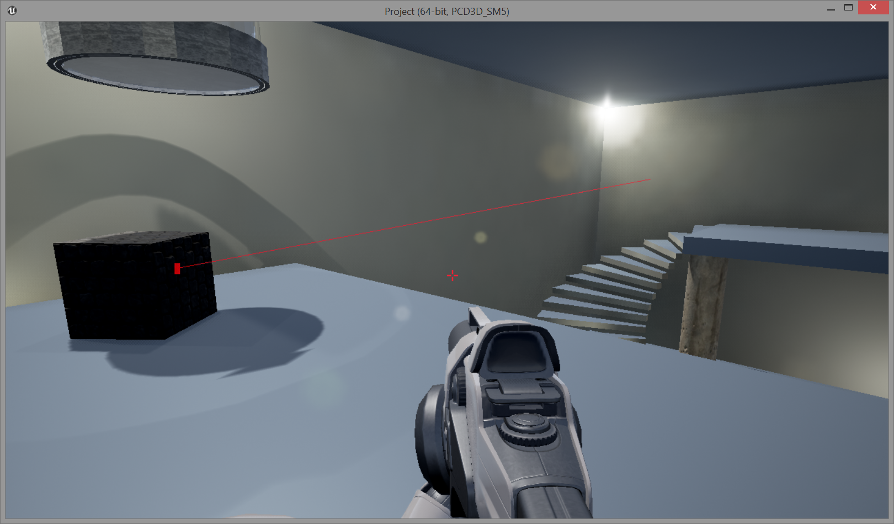
Line Segment
PinToolTip="Start\nVector \n\nStart of line segment."
PinType=(PinCategory="struct",PinSubCategoryObject=ScriptStruct'/Script/CoreUObject.Vector',bIsConst=True)
DefaultValue="0, 0, 0“
PinToolTip="End\nVector \n\nEnd of line segment."
PinType=(PinCategory="struct",PinSubCategoryObject=ScriptStruct'/Script/CoreUObject.Vector',bIsConst=True)
DefaultValue="0, 0, 0"
A Line segment is drawn after the prop is picked up/moved. This is to show the starting location of the player and the starting location of the item/prop.
This is for complete testing purposes only.

